Slide 1
cyber security Risk management PROGRAM.
1) Student Name: K.Maneeswaran
2) College Name: The Kavery Engineering College
3) Department: B.E-Computer Science And
Engineering

Slide 2
Definition:
> Cyber risk management, also called cybersecurity risk management, is the process of identifying, prioritizing, managing and monitoring risks to information systems.
> Cyber risk management has become a vital part of broader enterprise risk management efforts.

Slide 3
Outline:
1) Problem statement.
2) Proposed system.
3) System Development Approach.
4) Algorithm & Deployment.
5) Result (Output Image).
6) Condusion.
7) Future Scope.
8) References.

Slide 4
1)Problem statement:
> The current cyber security risk management practices within your organization lack comprehensiveness, scalability, and alignment with industry best practices.
> This deficiency exposes the organization to various cyber threats, including data breaches, malware attacks, and unauthorized access, which could result in financial losses, reputational damage, and regulatory non-compliance.
> Therefore, there is an urgent need to develop and implement a comprehensive cyber security risk management program tailored to the organization's specific needs and challenges.

Slide 5
2) Proposed system:
> The proposed Cyber Security Risk Management Program aims to fortify the organization's defenses against cyber threats, mitigate risks effectively, and ensure the integrity, confidentiality, and availability of its assets and data.
> The program will adopt a proactive approach, encompassing comprehensive risk assessments, robust policies and procedures, continuous monitoring, and a culture of security awareness.

Slide 6
3)System Development Approach:
> The development of a robust Cyber Security Risk Management Program requires a systematic approach that integrates risk assessment, policy development, technical implementation, training, and continuous improvement.
> This proposed development approach aims to ensure that the program is tailored to the organization's needs, effectively mitigates cyber risks, and remains adaptable to evolving threats and regulatory requirements.

Slide 7
4) Algorithm & Deployment:
Algorithm: | Deployment:
> An algorithm is a step-by-step procedure or set of rules designed to solve a specific problem or perform a particular task. | > Deployment refers to the process of making a software application available for use in a production environment.
> It's essentially a finite sequence of well-defined instructions that, when followed, leads to the desired outcome. | > It involves taking the application code, along with any necessary configurations, dependencies, and resources, and installing or activating it on the servers or infrastructure where it will be accessed by users.
> Algorithms can be found in various fields, including mathematics, computer science, engineering, and everyday life. | > Deployment is a critical step in the software development lifecycle, marking the transition from development and testing to actual usage by customers or end-users.

Slide 8
5) Result (Output Image):
> As an AI language model, I don't have the ability to generate or display images directly.
> However, if you have a specific question or task related to generating or processing images, feel free to describe it, and I can provide guidance, suggestions, or code.

Slide 9
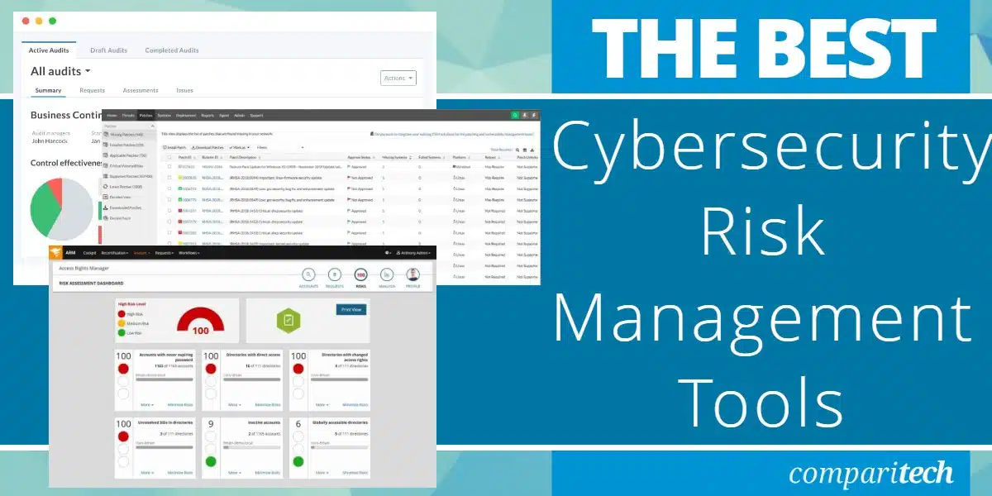

Slide 10
6) Condusion:
> In the realm of cyber security risk management, drawing conclusions involves evaluating various aspects of an organization's security posture to make informed decisions.
> Here are some key points to consider when drawing conclusions in cyber security risk management.

Slide 11
7) Future Scope:
> The future scope of cyber security risk management is continually evolving as technology advances and threats become more sophisticated.
> Here are some key areas where we can expect to see developments and focus in the future.

Slide 12
8) References.
>The "Cyber Security" refers to set of activities and measures, technical and non-technical, intended to protect computers, computer networks, related hardware and devices software, and the information they contain and communicate, including software and data, as well as other elements of cyberspace, from all threats.

Slide 13
Result:
> By developing and implementing a comprehensive cyber security risk management program, your organization can enhance its resilience to cyber threats, protect its assets and reputation, and ensure compliance with regulatory requirements.
> By implementing the proposed Cyber Security Risk Management Program, your organization can strengthen its cyber defenses, minimize exposure to cyber risks, and safeguard critical assets and data.

Slide 14
> By following this systematic development approach, your organization can effectively implement a Cyber Security Risk Management Program that addresses its unique needs, mitigates cyber risks, ensures compliance, and fosters a culture of security awareness.
> However, I can guide you on how to create a cyber security risk management program and discuss the potential outputs or results you might expect from such a program within your organization.

Slide 15
> Establish mechanisms for ongoing monitoring, review, and improvement of the organization's cyber security risk management practices.
> Overall, the future scope of cyber security risk management will require a proactive and adaptive approach to addressing emerging threats, leveraging advanced technologies, and implementing robust security measures to protect against cyber attacks.

Slide 16
> Furthermore, international standards such as ISO/IEC 27001 and ISO/IEC 27005 provide globally recognized frameworks for establishing information security management systems and conducting risk assessments.
> These standards emphasize the importance of continuous improvement and risk-based decision-making, aligning with best practices in cybersecurity risk management.

Slide 17


